Slide 1


Investment Behavior Analysis Report
A deep dive into participant investment preferences, reasons, and financial behavior, powered by comprehensive business analytics.

Slide 2

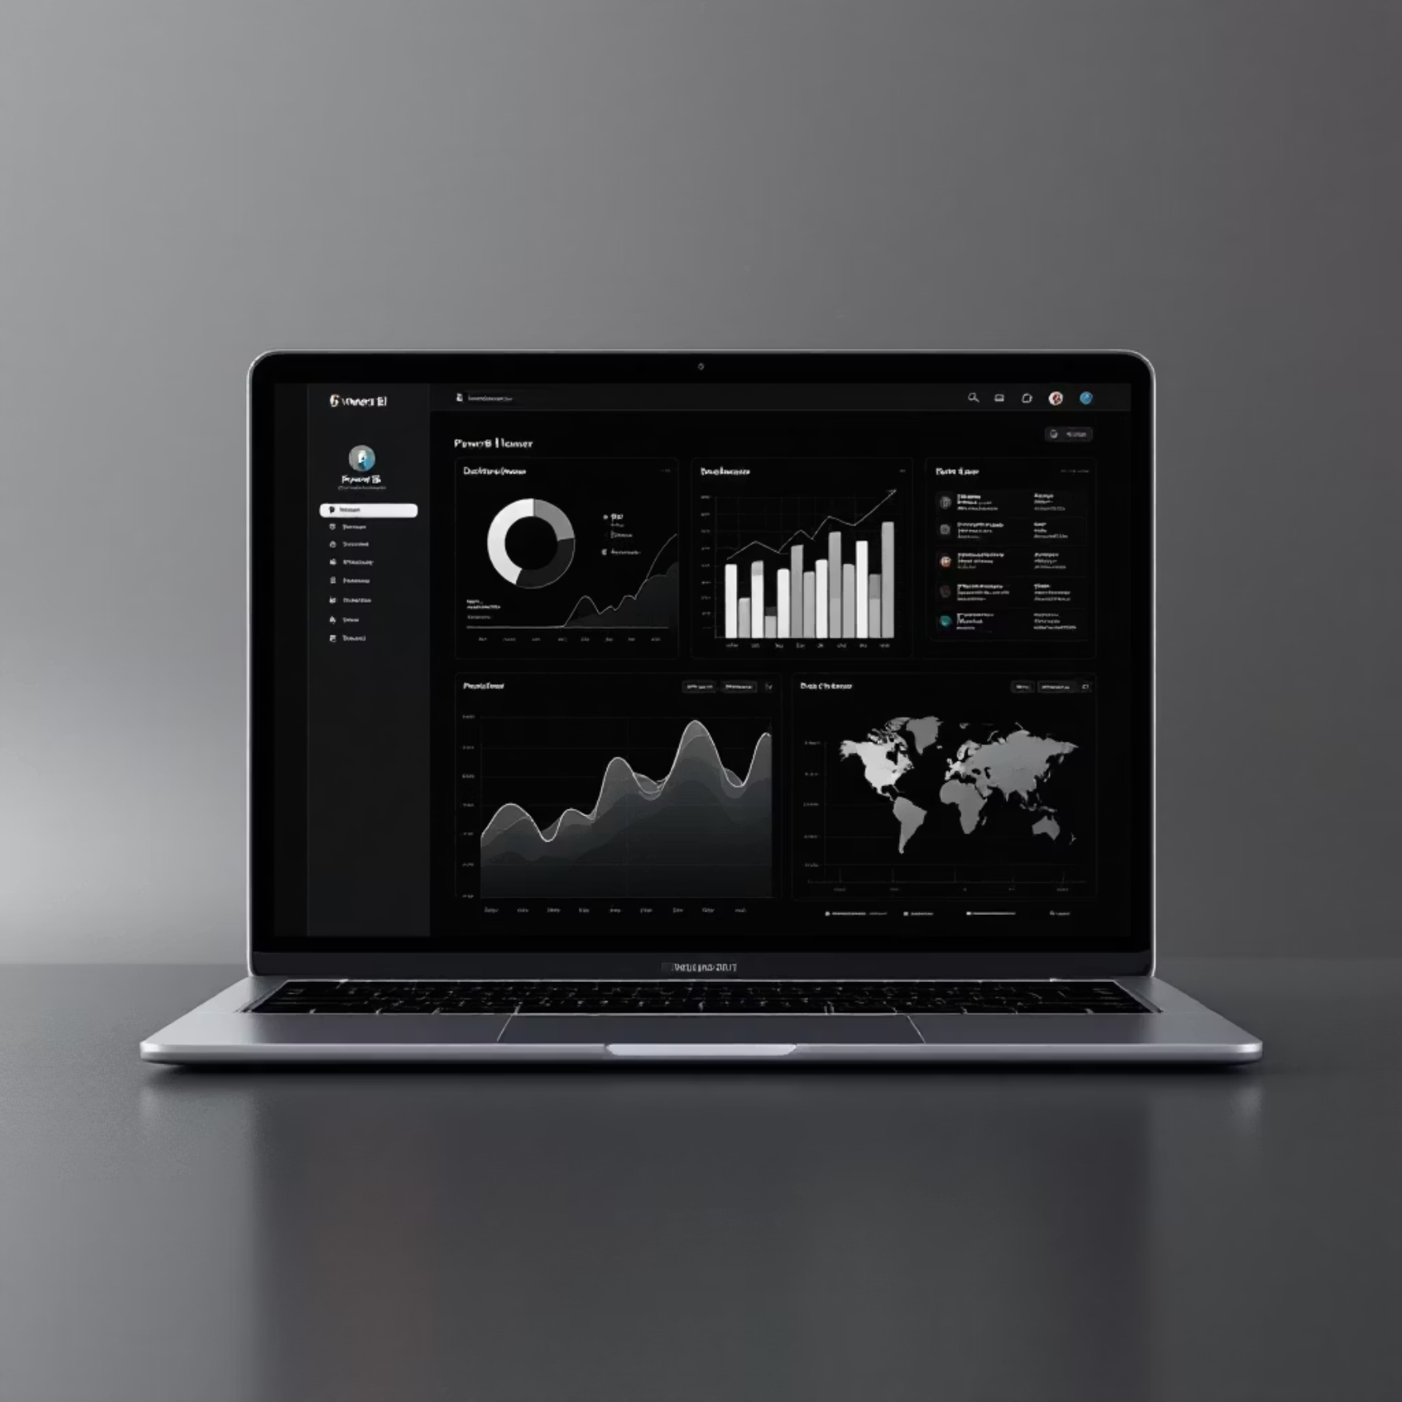
Project Objectives & Tools
Our primary goal is to meticulously analyze and visualize the intricate patterns within participants' investment preferences, underlying reasons, and overall financial behavior. We aim to extract actionable insights from the data.
Tools & Dataset:
Excel: Utilized for robust data cleaning, transformation, and initial analytical computations.
Power BI: Employed for creating dynamic and interactive visualizations that bring the data to life.

Slide 3





Gender Distribution Among Investors
Understanding the demographic makeup of our investor pool is crucial for targeted strategies. The distribution
reveals key insights:
Total Participants: 40 individuals were included in this analysis.
Male Dominance: Male participants constitute a significant majority, accounting for 62.5% of the
investment activity.
Significant Female Engagement: Despite the male lead, female participation stands strong at 37.5%, highlighting their active involvement in the investment landscape.
Insight: While male investors currently lead in numbers, the substantial female participation underscores a growing and important segment within the investment community.
Male Participants
25 individuals
Female Participants
15 individuals

Slide 4

Preferred Investment Avenues
Investors gravitate towards various instruments based on their risk appetite and financial goals. Here's a breakdown of the most popular choices:
45%
PPF (Public Provident Fund) accounts for 8%, often chosen for its tax benefits and long-term savings potential.
Mutual Funds
Popular for diversified portfolios
Fixed Deposits secure 22%, appealing to those seeking capital preservation
and steady returns.
25%
Equity
Chosen for potential high returns
Insight: A significant majority of investors prefer instruments with moderate to higher risk profiles, indicating a focus on capital growth rather than pure capital preservation.
22%
Fixed Deposits
Preferred for stability and safety
8%
PPF
Long-term tax-saving option
The data reveals a clear preference for instruments that balance growth potential
with manageable risk:
The largest share, 45%, opts for Mutual Funds, indicating a preference for diversification and professional management.
Equity investments attract 25% of participants, reflecting a pursuit of higher growth opportunities.

Slide 5
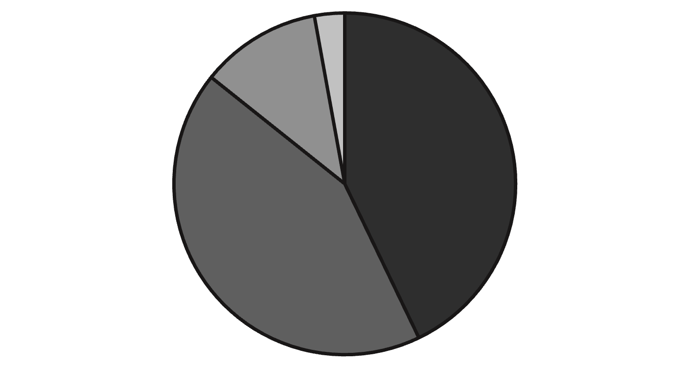

Key Motivations for Investment
Understanding the 'why' behind investment decisions provides valuable context. Participants' primary motivations are:
Capital Appreciation and Wealth Creation are the leading drivers, each cited by 30% of investors.
This highlights a strong desire for asset growth over time.
Dividend Income is a secondary motivator for 8% of participants, indicating an interest in regular income streams.
Liquidity is the least significant primary reason, at just 2%, suggesting that most investors are not prioritizing immediate access to funds from these investments.
Capital Appreciation
Wealth Creation
Dividend Income
Liquidity
Insight: The overwhelming focus on capital appreciation and wealth creation signifies a predominantly long-term
and growth-oriented investment mindset among participants.

Slide 6

Primary Savings Objectives
Savings are the bedrock of future financial stability. Participants' objectives for saving reveal their long-term priorities:
1
2
Retirement Planning
Education Funding
60% of investors prioritize securing their financial future post-employment, indicating a strong forward-looking perspective.
33% save specifically for educational expenses, reflecting a commitment to family and future generations' development.
3
Emergency Fund
7% focus on building an emergency fund, emphasizing a foundational step towards financial resilience.
Insight: The high percentages for retirement and education underscore that participants are deeply engaged in long-term financial planning, often extending to family well-being. Emergency funds, while crucial, are a smaller direct driver in this specific dataset.

Slide 7






Overall Investment Behavior Summary
Bringing together the various facets of investor behavior, we observe a clear and consistent profile:
Balanced Gender Representation
Preference for Growth Instruments
Long-Term Goals Drive Decisions
Despite a slight male majority, both genders are actively engaged in investment.
Mutual Funds and Equities are dominant choices, indicating an appetite for moderate-to-higher returns.
Motivations like wealth creation, capital appreciation, retirement, and education confirm a future-oriented approach.

Slide 8






Conclusion & Future Directions
Our analysis reveals a sophisticated and goal-driven investor base. This understanding paves the way for advanced strategic planning.
Goal-Oriented Investor Mindset
Deconstruct Behavioral Trends
The dataset strongly suggests a mature investor profile, characterized by clear objectives for long-term wealth and financial security.
Deep dive into specific investor groups to uncover nuanced behavioral patterns and psychological drivers influencing their choices.
Predictive Modeling
Refine Investment Strategies
Develop models to forecast future investment trends and potential shifts in preferences, allowing for proactive strategy adjustments.
Leverage insights for more personalized and effective investment products and advisory services.
By focusing on these next steps, we can further enhance our understanding of investor behavior and tailor our offerings to meet evolving financial needs.

